Slide 1
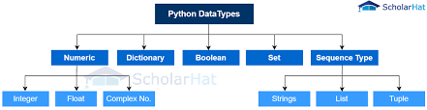
Data Types in Python
A Brief Overview

Slide 2
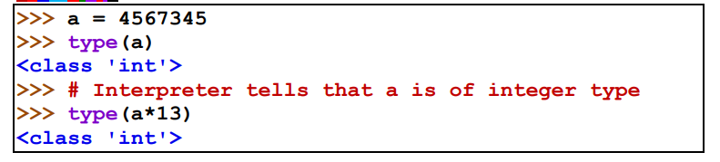
Numeric Types
1. int: Represents integers (e.g., x = 5)
2. float: Represents floating-point numbers (e.g., y = 3.14)
3. complex: Represents complex numbers (e.g., z = 1 + 2j)

Slide 3
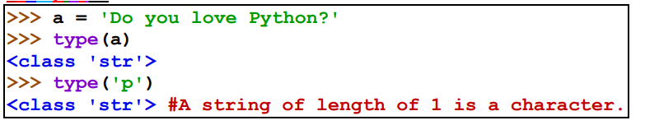
String Data Type
Definition: Sequence of characters.
Creation: Enclosed in quotes (e.g., s = 'Hello')
Key Operations: Concatenation, Repetition, Slicing

Slide 4
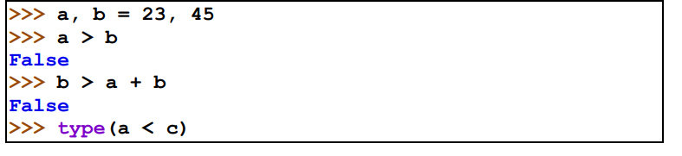
Boolean Data Type
Definition: Represents truth values.
Values: True or False
Usage: Control flow statements.

Slide 5
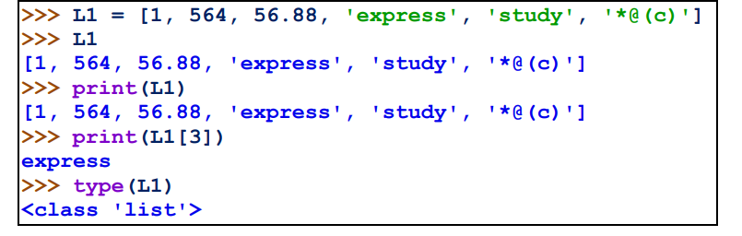
Sequence Types
1. List:
List is a sequence of values of any type.
Ordered, mutable collection (e.g., my_list = [1, 2, 3])
Indexed by integers.

Slide 6
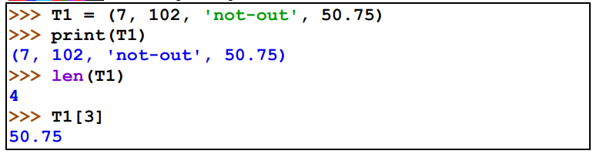
Sequence Types
2. Tuple:
Tuple is a sequence of values of any type.
Ordered, immutable collection (e.g., my_tuple = (1, 2, 3))
Tuple is enclosed in ( ) brackets.
Indexed by integers.

Slide 7
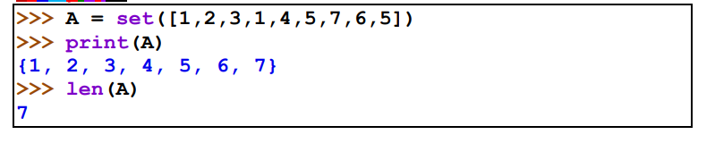
Set Data Type
Definition: Unordered collection of unique items.
Creation: my_set = {1, 2, 3}
Key Features: Removes duplicates, supports mathematical operations.

Slide 8
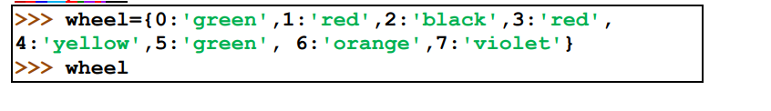
Dictionary Data Type
Definition: Collection of key-value pairs.
Which are indexed by other objects (keys) where keys are unique.
Creation: my_dict = {'key': 'value'}
Accessing Values: Using keys (e.g., my_dict['key'])

Slide 9
VARIABLES
Variable is like a container that stores values.
Can be accessed or changed as and when we need.
Ex: a = 5
RULES OF DECLARING VARIABLES:
1→ Variable names must have only letters, numbers, and underscores. They can start with a letter or an underscore, but not with a number
2→ Spaces are not allowed in variable names. Underscores can be used to separate words in variable names.
3→ Python keywords and function names cannot be used as variable name.

Slide 10
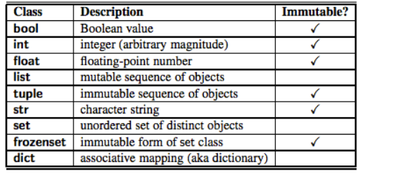
MUTABLE_VARIABLES VS IMMUTABLE_VARIABLES
A variable (object) whose value can be changed
in place, is called mutable variable.
Call by Address.
CRUD Operations.
------------------------------------------------------------
A variable whose value cannot be changed
in place, is called immutable variable
Call by Value.
No CRUD operations.

Slide 11
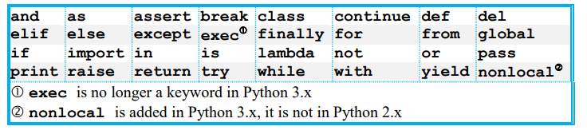
KEYWORDS
Keywords are the reserved words which are used by the interpreter to recognize
the structure of the program.
They cannot be used as variable name is like a container that stores values.

Slide 12
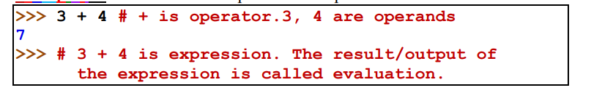
OPERATORS AND EXPRESSION
Operator is a symbol that does some operation on one or more than one values or variables.
The values or variables on which operation is done is called operand.
The operator(s) together with value(s) or/and variables, is called expression.
SOME IMPORTANT OPERATORS:
Arithmetic or Mathematical Operators ( +, -, *, /, //)
Relational or Comparison Operators (<, >, ==, !=)
Logical Operators (or / and / not)
Assignment or Shorthand Operators

Slide 13
Conclusion
Understanding data types is essential for effective programming in Python.
Next Steps: Explore how to use these data types in applications.

